Slide 1

Master of Computer and Information Sciences
Research Methods
Constructive Research/Design Science

Slide 2
Objectives
At the end of this session, you should:
  Understand the role of design Science in IT research
  Contrast the use of Design Science with other methods used in IT research

Slide 3


What is Research?
“There is no single, universally accepted definition of research. Definitions range from “finding the truth about nature” to “developing a solution to a problem”. In the context of engineering and technology, including industrial practice, research is viewed as a problem solving exercise.”

Slide 4
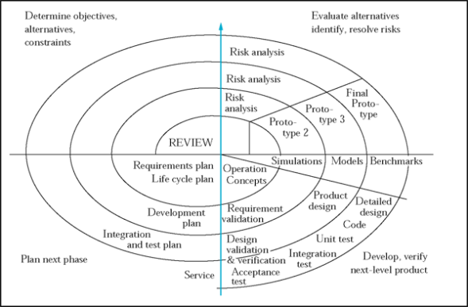
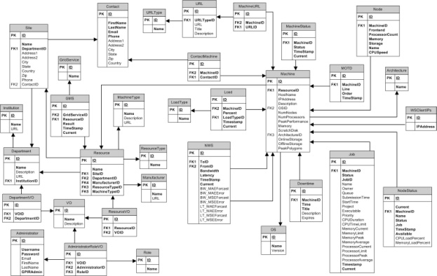
What is the ‘Design Science/Constructive method’?
From the supplementary textbook (Cornford and Smithson (1996) p44): “Constructive researchers are concerned with developing frameworks, refining concepts or pursuing technical developments.
The concern is with 'models and frameworks which do not describe any existing reality, but rather help to create a new one, and which do not necessarily have any "physical" realization (e.g. IS development methodologies)'…”

Slide 5
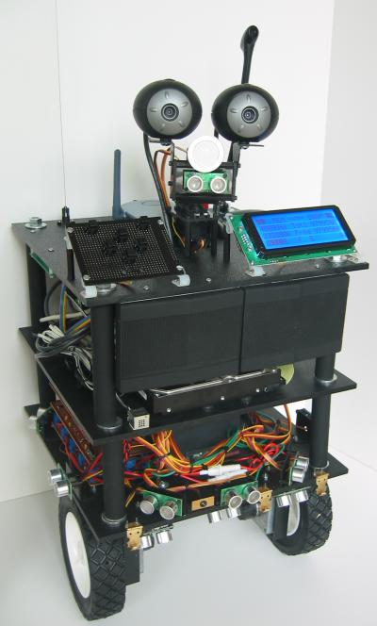
What is the ‘constructive method’?
In effect a means to:
  demonstrate feasibility of an approach
  produce a ‘proof of concept’
  build an innovative prototype system
  synthesise technologies
  enable technical students to do the type of research they want to do!

Slide 6
What is the ‘constructive method’?
“…In the information systems context there is a vast literature of this nature, and many opportunities to develop such work further. In particular, practical hands on computing might be seen as within this broad area in that the aim is to create something and make it work, rather than to observe an existing system working or theorize as to cause and effect.
If hands on computing projects go beyond 'making it work', to include 'observing it working' (and research projects must), then such work moves away from the narrowly constructive and takes on more of the flavor of an experiment or case study.”

Slide 7



Why have a constructive method?
To enable tool- or technology-centered research to be conducted in a rigorous manner
“Performances of understanding”
To increase the relevance of IT/IS research to practice
Because this type of work is not easily accommodated by other methods

Slide 8
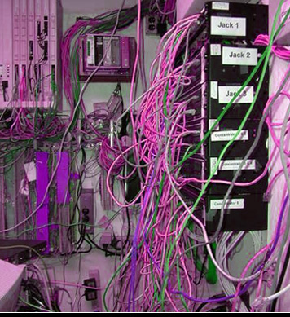

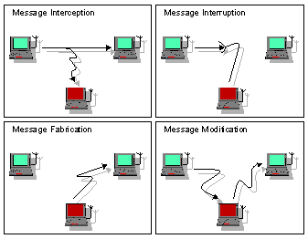
When should it be used?
When current tools/technologies present limitations e.g. wired infrastructure constrains mobile work
When new technologies enable advances to be made e.g. wireless infrastructure enables new methods of communication
When new technologies bring new challenges
  wireless infrastructure is insecure
  On line auctions need robust fraud detection software

Slide 9
Design Science vs. Routine Design
Routine Design is the application of existing knowledge to organizational problems – e.g. construction of a marketing information system
Design science solves:
Hitherto unsolved problems – in unique or innovative ways
Existing problems in more effective ways

Slide 10
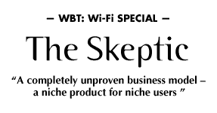


Limitations, warnings…
It can become an end in itself
It can be a little hard to sell
Danger of single-outcome syndrome
It is transient (as is all research) but may not be in the public domain
May just be chasing after practice

Slide 11


Limitations, warnings… (ctd)
Industry looking for silver bullet – but this changes monthly
Sometimes we would be better off adopting rather than inventing
When should the building stop?
Exemplars/cases need to be convincing and representative, but not contrived

Slide 12
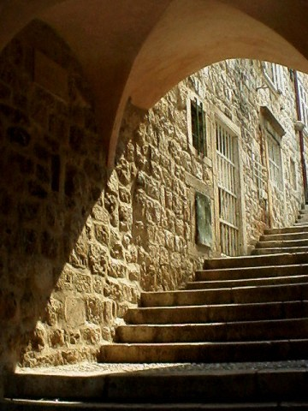
Steps in the constructive method
Context – big picture re technology
Identify limitations of existing tools
Describe problem/opportunity
Describe the importance of a solution
Choose criteria for success
Build design/architecture
Create prototype and exemplars
Evaluate against criteria

Slide 13
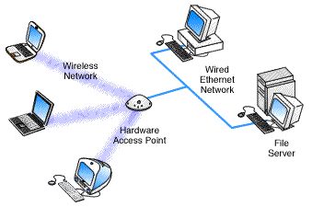
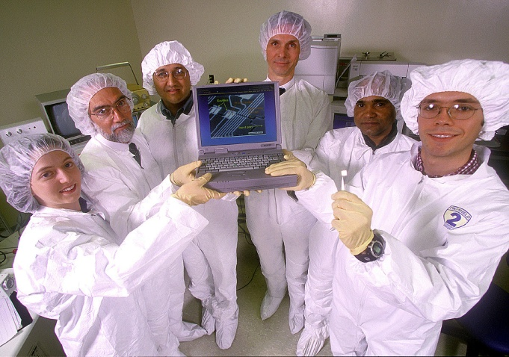
Understanding our stakeholders
In IS/IT we need to distinguish between two types of research questions: Type one are timely, topic-of-the-day research issues, and type two are timeless, recurring questions and dilemmas that have emerged over years and continue to be problematic
Let industry lead research in the former, and let research lead industry in the latter
Hirschheim and Klein (2003) page 279

Slide 14
My own Research
Mainly in the Data Mining/Machine Learning area
Almost all of my research has used the Design Science research method
Recent Examples
  Mining Mobile Call Patterns in NZ
  Detecting Fraud in On Line Auctions
  Mining high speed data streams
  Time Series Modelling and Prediction

Slide 15
My own Research: Case Study 1
Telecommunications company in NZ wanted to mine data streaming in from its mobile call network
Volume of data: approximately 10GB of compressed data streaming daily
Each record consists of 147 attributes and represents a call made by a subscriber
One of the objectives was to build (an almost real time) traffic prediction system
Other objectives included identifying the quality of call signals, classifying customer types, etc.

Slide 16
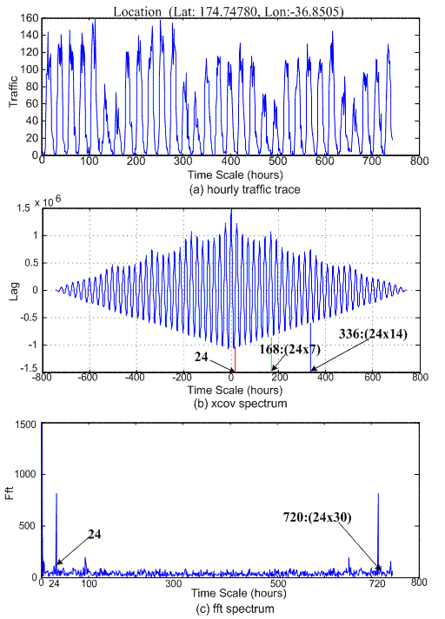
Time Series of Telecom Traffic: Sample

Slide 17
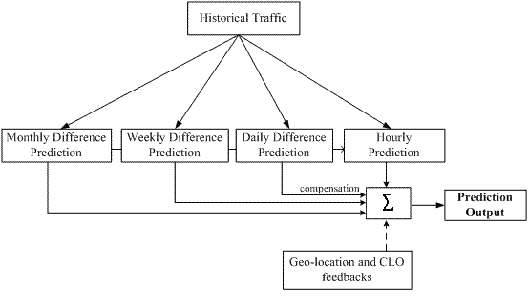
Case Study 1:Proposed traffic prediction solution

Slide 18
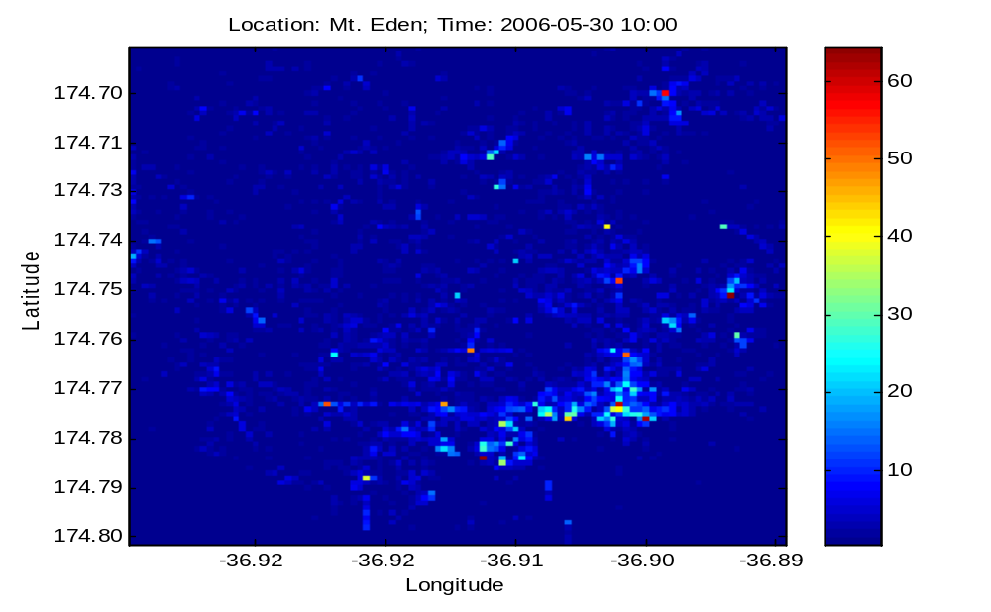
Case Study 1: Results: Actual Traffic Density

Slide 19

Results: Predicted Traffic Density

Slide 20
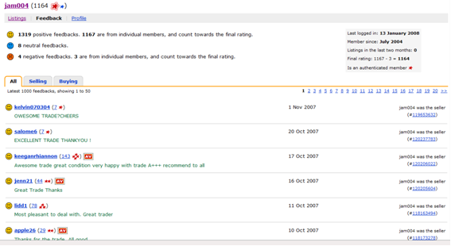
Case Study 2: Auction Fraud
Main objective was to identify fraudulent users and their
accomplices

Slide 21
Auction Fraud Detection
Two step approach:
Classified auction users into two categories, honest and fraudulent based on the pattern of transactional activity – implemented by using machine learning methods on historical data to induce a model
Used a statistical method (Markov Random Fields) to derive cliques consisting of fraudulent, accomplices and honest users interacting with each other

Slide 22
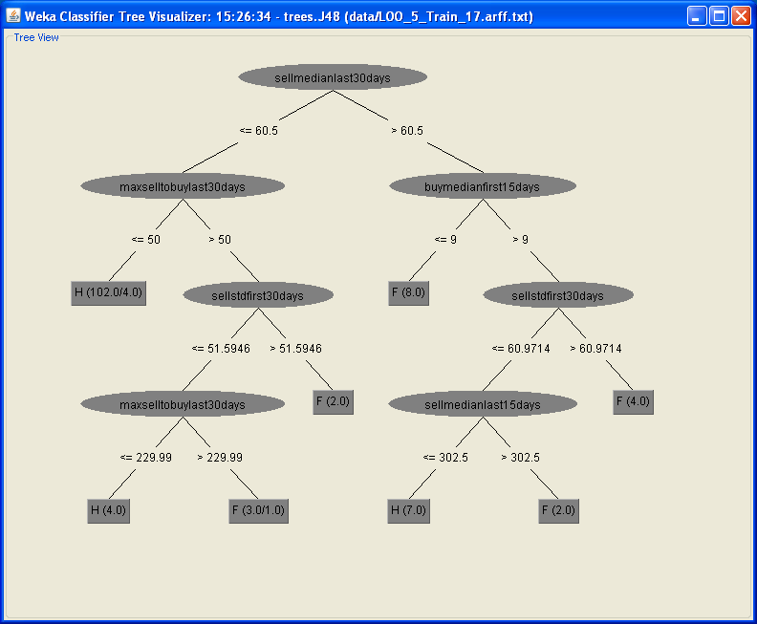
Categorizing Auction Users into Honest and Fraudulent Types

Slide 23
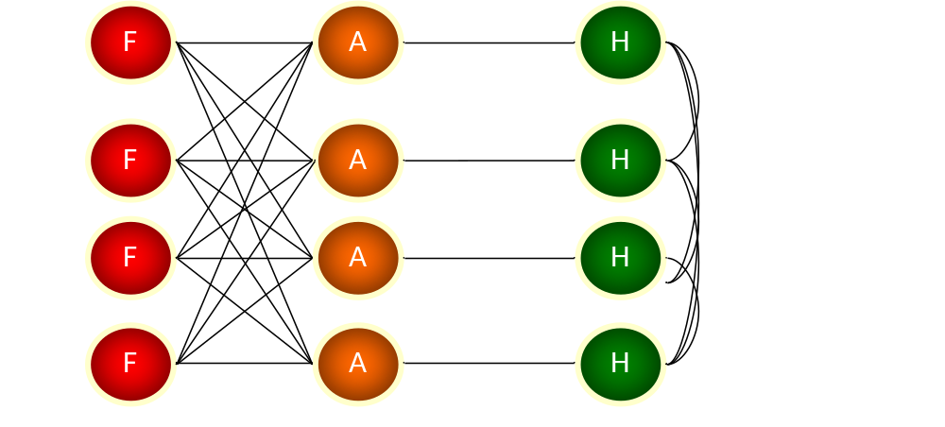
Case Study 2: Auction Fraud

Slide 24

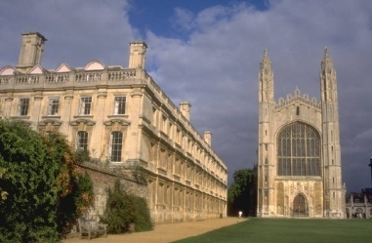

Traditional research dichotomy
Object
Scope
Credibility
Timeline
Rationale
Emphasis
Attitude
Success?
University
  Question
  Flexible
  Independent
  Long
  Pure
  R & d
  Publish
  Papers
Business
  Product
  Fixed
  Limited
  Short
  Applied
  r & D
  Protect
  $$$

Slide 25
The (Dis)Connection
Industry
research
Academia
research
education
education

Slide 26
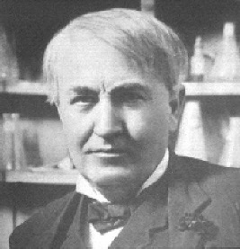
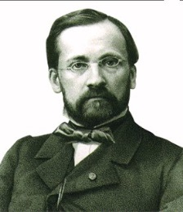
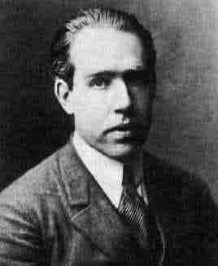
Research quadrants
Edison | Pasteur
 | Bohr
(High)
Utility
(Low)
(Low)
(High)
Fundamental
Understanding
(Denning, P.J. (2002) Flatlined. Communications of the ACM 45(6): 15-19)

Slide 27
Early Work in Design Science
Nunamaker (Nunamaker, 1991) represents the early work done in the area of design science
Nunamaker proposed a multi-methodological approach to building information systems where Experiments, Case Studies, Simulation, Mathematical Methods, etc may be used to build information systems

Slide 28
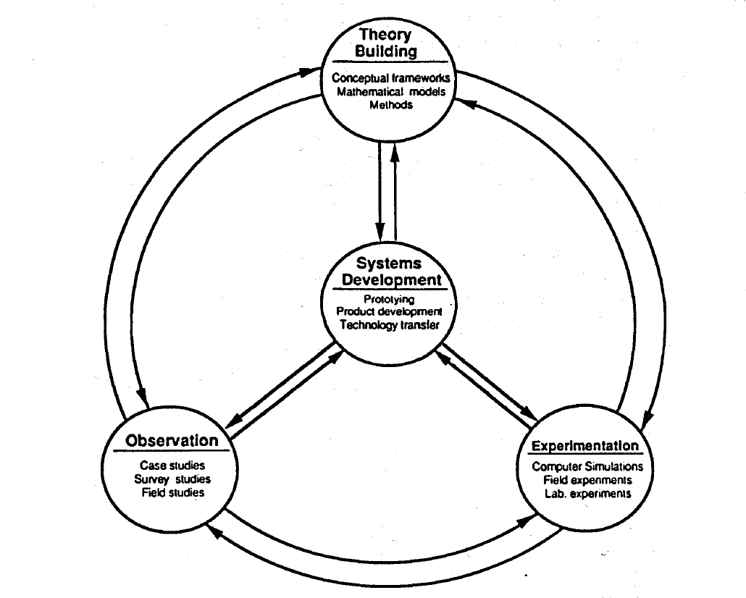
Nunamaker’s Multi-Methodological Approach

Slide 29
Design Science Fundamentals
Two major types of research activities (March and Smith, 1995):
Descriptive research – aims at understanding the nature of IT
Prescriptive research – aims at improving IT performance

Slide 30
Natural Science vs. Design Science
Natural Science is concerned with explaining the behaviour of the Universe – involves Knowledge Discovery and Justification
Knowledge discovery is a creative process that is not well understood
Scientific study uses the hypothetico-deductive method – theories can be tested as long as hypotheses can be deduced from them
Design science is concerned with devising artefacts to attain goals – technology oriented

Slide 31
Design Science Framework
March and Smith (1995) proposed a framework consisting of a matrix of activities and outputs.
Two key activities are Build and Evaluate
Weber (Weber, 1987) says that IT research is the study of artefacts as they are adapted to their changing environment
Hevner, March, Park and Ram (2004) also proposed a similar framework to March et al that also emphasized the building and evaluation of artefacts

Slide 32
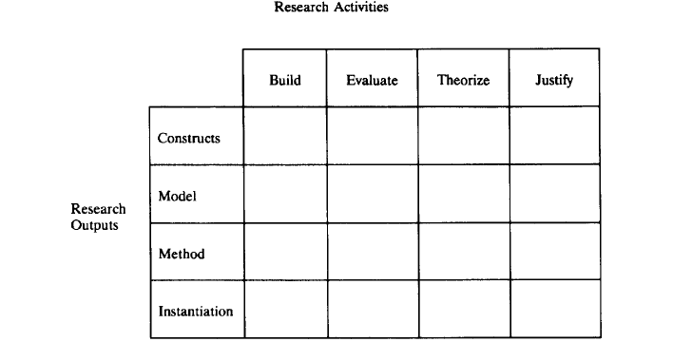
Framework (contd.)

Slide 33
Framework (contd.)
Constructs – fundamental concepts from any given application domain – e.g. Entities, Attributes, Relationships, etc
Model – set of prepositions (statements) that express relationships among constructs
Method – set of steps to perform a task
Instantiation – put into operation constructs, models and methods

Slide 34
Framework (contd.)
Build – construction of the artefact to demonstrate feasibility
Evaluate – assess how well the artefact works – e.g. metrics in algorithm design
Theories – make explicit the characteristics of the artefact – theorize about semantic databases
Justify – gather evidence to justify theory – can be done analytically or empirically

Slide 35
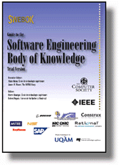
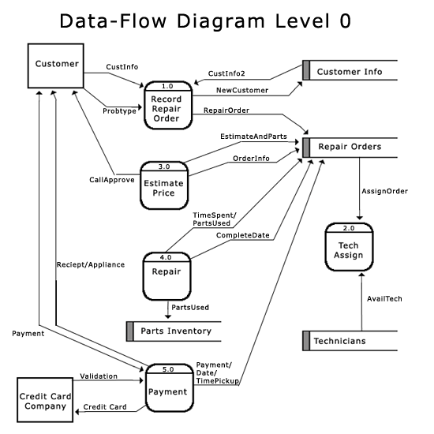
Important notes!
Justified selection of criteria is crucial
The work must still tell us something new
  add to the body of knowledge, and/or
  lead to change in practice
Building a system/tool for its own sake is not research
Still requires a prior review of the literature plus a technology assessment

Slide 36
References
Klabbers, J. H. G. (2006), “A framework for artifact assessment and theory testing”, Simulation & Gaming, 37(2), 155-173.
Maddox (2001)
Nunamaker J, Chen M & Purdin T, “Systems Development in Information Systems Research”, MIS Quarterly, 7:3, 1991.
March S & Smith G, “Design and natural science research o information technology”, Decision Support Systems, Vol. 15, 1995.
Hevner A, March S & Park J, “Design Science in Information Systems Research”, MIS Quarterly, 28:1, 2004.
Weber R, “Toward a Theory of Artifacts: A Paradigmatic Base for Information Systems Research”, Information Systems, 1:2, 1987.

